Slide 1
Internal Affairs
Suggestions for conducting Effective Investigations

Slide 2
INTRODUCTION TO
INTERNAL AFFAIRS INVESTIGATION
KEY INITIAL QUESTIONS
Does your entity have an investigation protocol?
LEXIPOL 1010- Personnel Complaints
Professional Conduct/Anti-Harassment Policy
2) Does your entity have written guidelines for conducting the investigation?
3) Does the CBA or SOG’s address the issue?

Slide 3
SUGGESTED GUIDELINES TO KEEP IN MIND GOING THROUGH THE PROCESS
Make a plan for conducting the investigation
Provide notice to the person under investigation
Take steps to preserve all evidence and documents
Conduct proper interviews
Prepare the report
Package up all key items to provide to the decision maker
Mitigate legal risks – ask the attorneys
DOCUMENT – DOCUMENT – DOCUMENT / RECORD- RECORD- RECORD
Keep in mind the duty to protect the rights, privacy, reputation of the investigation, the investigator, the complainant, the subject and others while still ensuring a full and effective investigation
Note
KEY PRINCIPLES FOR THE INVESTIGATION
PROMPT AND THROUGH
CONFIDENTIAL AND FAIR

Slide 4
RECOGNIZING A COMPLAINT THAT MIGHT WARRANT INVESTIGATION

Slide 5
Citizen complaints

Slide 6
Oral Complaints
Should they be accepted? - YES
Why Not?
Goal is to be a good partner with the community.
Reduce the “Fear” factor

Slide 7
CITIZEN FORMAL Complaints
Create a form
Put the form online where possible
Provide form at front desk of P.D, City Hall, and Municipal Court.
Have form available in Patrol units
Assist those who have limited writing skills or limited English language skills
know who has the ability to serve as translator(s)
SUGGESTION: Cities should have complaint forms for other Departments

Slide 8
Should you require the complaint to be notarized?
Possible chilling effect since many people do not have access to a notary
People may not want to come into the Police Department or City Hall due to fear of running into the officer OR general distrust of law enforcement
Federal law allows an unsworn declaration under penalty of perjury. See 28 U.S. C. §1746: “I declare (or certify, verify, or state) under penalty of perjury that the foregoing is true and correct”
Oklahoma does not have a similar statute
Bill of Right: CBA (often states that complaint must be under oath) vs. Lexipol- (Chapter 10) vs. Handbook

Slide 9
Review and analyze each complaint
“Small” complaints (ex. Officer was rude)
Middle level complaints
Serious complaints
Chronic complainer OR is the officer a frequent subject of complaints albeit not “major” ones
Might be a sign to step in and address the behavior before it reaches the level of warranting an official I.A.

Slide 10
KEY: do not ignore a complaint
All complaints deserve some response even if it is merely telling the citizen that you have spoken with the officer and appreciate the citizen bringing his/her concern to your attention.

Slide 11
Complaints from other law enforcement agencies

Slide 12
Jurisdictional Issues – Try to clarify As Soon As Possible
Body Camera – Dash Camera Footage (Who owns the evidence?)
Standing Issues Between the Entities
Involvement of the District Attorney’s Office at the front end.
Issues following McGirt v. Oklahoma 140 S. Ct. 2452 (2020)- Involve Tribal Police and U.S. Attorney’s Office

Slide 13
Internal complaints

Slide 14
Often difficult to handle correctly
Create a written process for the filing of internal complaints and make it clear that they will be taken seriously, but also make clear the penalty for false reporting
NO presumption that the complaint is bogus
Consider any need for affirmative action while complaint is under review

Slide 15
Separate the parties if on the same shift until a decision is reached
Make sure to separate the supervisor from the subordinate if both are implicated in the complaint
Make it clear that the Department will not tolerate any intimidation, harassment, coercion, or threats.
Keep politics out of the process – including FOP politics
Respect the privacy rights of all parties i.e. complainant, witnesses, and accused– be mindful of possible damage to reputation if allegations are false

Slide 16
Initiating the investigative process

Slide 17
Step one

Slide 18
KEY: Determine to the best of your ability at the very outset whether the complaint, if true, could reflect a violation of one or more criminal statutes

Slide 19
IF SO: The same agency normally SHOULD NOT investigate both the criminal aspect and the personnel aspect of the complaint
Possible Exception: Large departments that have public integrity units with trained Officers.
Consider how public would view the Police Department “policing” its own members.

Slide 20
HOWEVER:
Just because a criminal charge may be filed against an officer does not mean you must forgo a prompt internal investigation
Criminal charges take a long time to go through the system
Discipline can be taken even while charges are pending or still under investigation
Even termination while the criminal charges are pending

Slide 21
WHO GOES FIRST: When possible and where it will not adversely impact the investigation into possible criminal violations – the Department can run its investigation parallel with the criminal investigation.

Slide 22
REMEMBER: The Department MAY NOT use any report prepared by the OSBI in a criminal investigation as the basis for taking any internal personnel action. See 74 O.S. § 150.5(D). Therefore, there must be a separate internal administrative investigation.

Slide 23
The process to be used

Slide 24
BEGINNING THE PROCESS
IDENTIFY THE SPECIFIC ALLEGATIONS
Seeking clarification from complainant – in writing whenever possible
Ask for documentation including electronic documents from the complainant as soon as possible; including the identity of others who may have relevant documents;
Advise the complainant to maintain all relevant materials.
Seek identification of possible witnesses and the knowledge they may posses
Prepare a time-line of events
Prepare a preliminary schedule of interviews

Slide 25
Check to see if any Collective Bargaining Agreement (CBA) contains a provision for internal investigations
Frequently CBAs contain provisions under headings such as “Police Officer Bill of Rights” (These often only address citizen complaints.)

Slide 26
Lexipol or SOG or Departmental Policies – Check to see if they address the process that is to be used.
Check to make sure no conflicts among:
CBA vs. Lexipol vs. SOG vs. Handbook vs. Charter vs. Ordinances

Slide 27
DUE PROCESS:
Cleveland Board of Education v. Loudermill,
470 U.S. 532 (1985)
TWO ASPECTS:
1) Fair and complete investigation
and
2) Employee’s right to respond

Slide 28
This case stands for the proposition that where a public employee has a vested property right in continued employment, he/she may not be deprived of that right without due process of law – the right to be heard in a meaningful time and meaningful manner

Slide 29
WHO Has a Vested Property Right?
Under most CBAs and the Police Pension and Retirement System statute, 11 O.S. §50-123, an officer who may only be disciplined for “cause,” “just cause,” or “good cause shown” has vested property interests in continued employment . . .
Therefore, the officer is entitled to due process before deprived of that right via substantive discipline.
The term “Substantive Disciplinary Actions” is not limited to just terminations, demotions, or suspension without pay

Slide 30
STATUS OF PROBATIONARY EMPLOYEES:
CBA: FOP Lodge No. 1080 City of Ardmore, 2002OK19, 44 P.3d 569= held probationary employees are not deemed “permanent members”
For grievance/ arbitration rights
Pension statue: Brewer v. City of Seminole, 2014 OK 41, 326 P.3d 1143: Probationary employees are not entitled to Police Board of Review under 11 O.S. § 50-123
As such: May be deemed at will EXCEPT if granted rights under a City Charter

Slide 31
SUGGESTION: Follow This Process for All Employees
Written Notice: Send a notice to the officer indicating that he/she is under investigation; the basic factual basis for the investigation; and the officer’s obligations in the investigation, i.e. in return for being compelled to respond to your questions. The information CANNOT be used in a criminal proceedings or shared with the D.A. etc.
Prepare a Supplemental Written Notice: This is needed where new information comes to light during the initial investigation
Officer’s Right: Due process requires that an officer has the right to be heard and to respond to the charges “in a meaningful time and meaningful manner.” The officer can only do so if he/she has been provided with sufficient facts to know what the allegations are based on i.e. the events.

Slide 32
Garrity v. New Jersey, 385 U.S. 493 (1967): provide written notice of the employee’s rights and obligations i.e. in return for being compelled to respond to your questions. The information CANNOT be used in criminal proceedings or shared with the D.A. etc.
NLRB v. Weingarten, 420 U.S. 251 (1975): right to have a union representative present where the questioning may reasonably lead to discipline – also can have an attorney present – these are observers and to provide guidance to the officer – not to be active participants in the questioning.

Slide 33
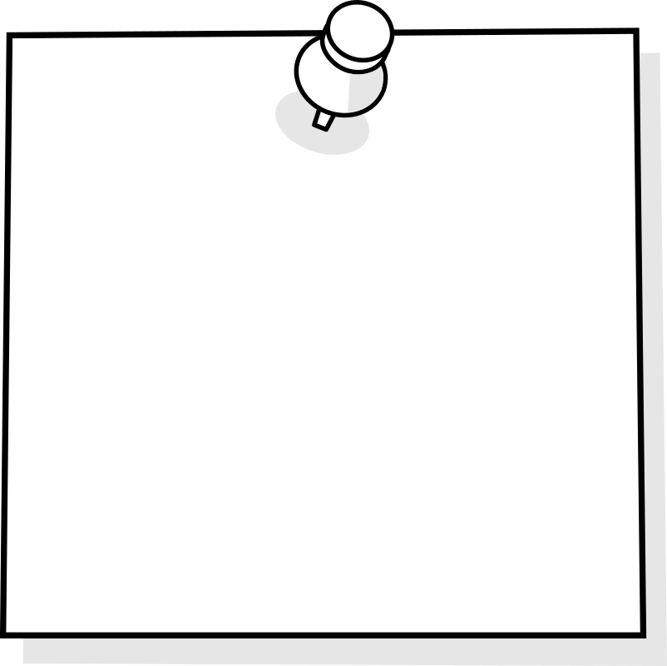
Courts have held that even if an officer is not covered by a CBA and does not have a vested property right to continued employment (for example, probationary officers), or where discipline can be taken “for the good of the service”, if the City/Department has established procedures to be used before an adverse employment action is taken, failure to follow those procedures will give the officer a cause of action against the City.
See Kester v. City of Stilwell, 1997 OK CIV APP 1, 933 P.2d 952.
Note

Slide 34
Record the interviews: – both the major ones and the minor ones – since you never really know where the investigation will lead.
Time Limits: Check to see whether there are set time limits for completion of the investigation and whether there is a process to obtain an extension of time – document any requested extension and any new time table
Be detailed and thorough in the investigation – do not overlook details or witnesses.

Slide 35
The investigator

Slide 36
Check to see if there is are any limitations on who can conduct the investigation
Some policies only allow for Internal Investigators
IF SO: TRY TO GET THIS CHANGED

Slide 37
internal Investigator:
The Plus Side
The Down Side
Normally will know some or all of the relevant parties and witnesses
Should know the policies and procedures of the Department
May have had I.A. training or has had training in investigative techniques
If a citizen complaint – may lead to a belief of a cover up “The Blue Line”
May be impacted by internal factions within the Department
Certain complaints may be outside of the skill set of an officer

Slide 38
Complaints requiring specialized skill set
Complaints that implicate federal or state statues – such as civil rights, sexual, gender, race, age, disability discrimination and the like
Complex computer crimes/ white collar crimes
Where there is a highly technical aspect to the investigation
The “Hot Potato” case
Be sensitive to the victim and how he/she may view the investigation

Slide 39
external investigator:
The Plus Side
The Down Side
Frees up manpower in the Department
Often can complete the investigation more quickly since focused on one matter
Perception of objectivity
Can possess the special training, knowledge and skill set needed for certain investigations
May be viewed with skepticism by members of the Department – so it may take longer to gain trust
May not be versed in certain police techniques that could come into play
May be viewed simply as the “hit man” for management – this may be a key concern if the complaint is part of an ongoing internal dispute among factions of the Department

Slide 40
ADDITIONAL ISSUES TO CONSIDER WITH OUTSIDE INVESITGATOR
CULTURE OF THE ORGANIZATION
Does the investigator have a background in law enforcement or the topics involved in the complaint
If not, the person may not understand
The lingo being used
May miss what the person is trying to convey
May not know the correct questions to ask
ATTORNEY AS THE INVESTIGATOR
Attorney – Client privilege issues that might arise
Making clear that the attorney is working for the City NOT the complainant or the respondent
Can end up as a witness in arbitration or lawsuit = The “Two Hate” dilemma

Slide 41
Make sure the investigator has the time to devote to the investigation and will make a commitment to conduct a thorough investigation.

Slide 42
CONDUCTING INTERVIEWS
REMEMBER: This is an internal investigation NOT a criminal investigation – show respect.
Watch your tone of voice and non-verbal actions
PREPARE AN OUTLINE OF QUESTIONS
Listen to the person- rather than just asking questions – look for clues in speech and body language
Remember the power of silence
PREPARE STANDARD INSTRUCTION TO EACH WITNESS
Need to keep the investigation confidential
Stress that retaliation/harassment will not be tolerated and method to report any claims of retaliation
Make it clear who you represent and who you do not represent
Encourage witnesses to provide any additional information that might come to mind i.e. other witnesses or documents- So provide contact information

Slide 43
Completing the investigation

Slide 44
Written report of Investigation
Summary of Findings
Details of the facts discovered supporting each finding
Index of witnesses interviewed – in major cases a summary of their information/key knowledge
Index to exhibits reviewed and those relevant to finding
Transcripts of interviews if transcribed

Slide 45
recommendations
Suggest the investigator NOT make disciplinary recommendations
Suggest the investigator NOT play lawyer unless, of course, the investigator is a lawyer

Slide 46
Role of the chief of police

Slide 47
Review the report
Make sure you are satisfied that the investigation was thorough
IF NOT
Send it back for supplementation

Slide 48
Make a preliminary determination
Does it appear that the allegations are sustained on the facts and evidence as presented in the report – If not, notify the officer that the matter is closed and a determination has been made that the allegations are not sustained.
Remember: The complainant should be notified that the investigation is finished

Slide 49
In the Alternative . . .

Slide 50
Pre-determination conference notify the officer in writing that:
The investigation is completed – attach a copy
The facts as developed, if not otherwise explained, would appear to support a violation of one or more policies
Set up a time for a pre-determination conference
Reiterate the officer’s continued rights under Weingarten i.e. right to representation at the pre-determination hearing
Record the pre-determination hearing – officer also has a right to record the hearing.

Slide 51
The Courts have held that where an officer has an appeal right, such as under a CBA’s grievance provision, the pre-determination hearing does not need to be elaborate – it is designed to serve as a “preliminary check” against an erroneous decision.
See Hennigh v. City of Shawnee, 155 F.3d 124 (10th Cir. 1998)
Note

Slide 52
Make a final determination
Determine whether violations have occurred
Depending on the form of government and the authority of the Chief: Send a cover letter to the City via:
City Manager/Mayor/Board of Trustees

Slide 53
SEVEN TESTS for just cause
In 1964, Arbitrator Carroll Daugherty created “The seven tests of just cause” standard to support discipline in the form of seven questions – These are good “guidelines” to consider.
1. Fair Notice: As a general rule, an employer may not discipline an employee for violating a rule or standard whose nature and penalties have not been made known.
However, this doesn’t apply to self-evident misconduct. Such as theft, insubordination, fighting, and sleeping on the job. The rules should be clear and should not be ambiguous or vague, such as do not engage in “boisterous conduct” or do not exercise “poor judgment”

Slide 54
SEVEN TESTS for just cause
2. Prior Enforcement: An employee may not be penalized for violating a rule or standard that the employer has failed to enforce for a prolonged period.
However, an employer who has not enforced a rule in the past can “reset” its policy with proper notification to employees that it will punish all offenders in the future.

Slide 55
SEVEN TESTS for just cause
3. Due Process: An employer must conduct an interview or a hearing before issuing discipline, and must take action as promptly as possible where the Employee has a vested property right in employment.

Slide 56
SEVEN TESTS for just cause
4.Credible Evidence: Charges must be proven by credible evidence.
An employer should not discipline an employee based on a rumor, speculation, or gossip. The employer has the burden of proof regarding the alleged misconduct and the appropriate penalty.

Slide 57
SEVEN TESTS for just cause
5. Equal Treatment/ Comparable Discipline: Generally, an employer should not assess a considerably stronger punishment against one employee than it assessed against another known to have committed the same or a substantially similar offense.
However; prior disciplinary history can be considered i.e. progressive discipline.

Slide 58
SEVEN TESTS for just cause
6. Progressive Discipline: When responding to misconduct that is short of egregious (very serious), an employer should issue the one level of discipline that allows the employee an opportunity to improve.

Slide 59
SEVEN TESTS for just cause
7. Mitigating and Extenuating Circumstances: Discipline must be proportional to the gravity of the offense, taking into account any mitigating, extenuating, or aggravating circumstances.

Slide 60
Cover letter should:
Outline briefly the factual background
Attach the report of the investigator
Provide any pertinent background of the officer such as prior disciplinary history or prior exemplary service
Make a recommendation
Consider degree of discipline in prior cases – comparable discipline
Issues of progressive discipline

Slide 61
Thinking ahead

Slide 62
Grievance arbitration

Slide 63
The standard used may vary from arbitrator to arbitrator depending on the degree of discipline
Preponderance of the Evidence: Most commonly used
Clear and Convincing Evidence: Some arbitrators use this in termination cases
Seven Just Causes for Discipline: old school but still used (hardest)
HOWEVER: good check list to use to see if the investigation was thorough

Slide 64
Police pension board hearing

Slide 65
This applies to Police Chiefs and non-probationary officers who are members of the police pension system and are not covered by a CBA or merit protection system.
Remember: Two officers are to be on this board = Present or retired officers of the Department
Two civilians: Doctor and a Lawyer: Must live in the community
Mayor
Fail safe in statute to fill slots with City Council members/Trustees

Slide 66
LAWSUIT

Slide 67
Consideration should always be given as to how outside persons and entities will view the materials.

Slide 68
MOST COMMON MISTAKES
Person receiving the complaint is biased for or against the:
Officer
Complainant/ Victim
And fails to process the complaint through the Chain of Command
Person assigned the investigation has had negative contacts with:
Officer
Complainant/Victim
And allows contact to influence his/her actions

Slide 69
MOST COMMON MISTAKES
The investigator fails to do a complete investigation due to:
Time constraints
Lazy- lack of interest
Lack of necessary skill set
Leaves the Complainant in the Dark
Not following up with witnesses as necessary
Fails to obtain relevant evidence
Chief of Police: does not send the report back for further investigation if it is determined the investigation has flaws

Slide 70
MOST COMMON MISTAKES
Recommendation of Discipline: failure to consider
Progressive Discipline
Comparative Discipline
Time Lines – failure to adhere to time requirements to complete each step as set forth on
CBA
SOG
Lexipol
City Policies
NOTE: suggest cities create a check list for each step in the process.

Slide 71
MOST COMMON MISTAKES
Failure to maintain adequate records of the investigation
Recording interviews
Diary of steps taken
Notes
Photographs
Documentation of Evidence
Consultation with experts
Failure to follow up on items identified in discipline
Identified training needs
Identified follow up with supervisor
Follow up on any Plan of Improvement
Failure to take Remedial Action

Slide 72
Fundamental question
Was the Investigation Fair and Thorough?

Slide 73
Contact information
Margaret McMorrow Love
The Love Law Firm
228 Robert S. Kerr Ave., Suite #540
Oklahoma City, Oklahoma 73102
405-235-3848
mml@lovelawfirm.legal

